Slide 1

Artificial Intelligence BAI402
Balaji Vijaykumar B.E.,(NIE), M.Tech.,(SJCE)
Assistant Professor, Department of CS&E-AIML
The National Institute of Engineering, Mysuru
(Former Research & Development Engineer @ Philips R&D)
(Former Software Engineer @ Accenture)

Slide 2

Introduction to the Structure of Agents
Introduction:
So far, we have discussed agents by describing their behavior—actions performed after any given sequence of percepts.
Now, we will explore how the internal workings of an agent function.
The main task in AI is to design an agent program that implements the agent function, which is essentially the mapping from percepts to actions.

Slide 3
Agent = Architecture + Program
This agent program runs on some form of computing device equipped with physical sensors and actuators, collectively referred to as the architecture.
The concept of an agent can be encapsulated by the equation:
Agent = Architecture + Program
Architecture: The physical platform that hosts the agent program. This could range from a simple PC to a complex robotic system with multiple sensors and actuators.
Program: The software component that processes percepts (inputs from the environment) and decides on actions to be taken. The program must be compatible with the architecture's capabilities.

Slide 4
Agent = Architecture + Program
Example : Consider a self-driving car:
Architecture: Includes the car’s hardware such as cameras, LIDAR, GPS, and the onboard computers.
Program: The software that processes data from the sensors to navigate the car safely.
The architecture plays a crucial role in the functionality of the agent: Perception, Processing, Action
Example: A robotic vacuum cleaner:
Sensors: Detect dirt, obstacles, and room layout.
Program: Determines the optimal cleaning path.
Actuators: Motors that move the vacuum and control the cleaning mechanism.

Slide 5
AGENT PROGRAMS
Agents perceive their environment through sensors and act upon it using actuators.
There is a difference between an agent program and an agent function: an agent program takes the current percept as input whereas an agent function takes the entire percept history.
The agent program takes just the current percept as input because nothing more is available from the environment; if the agent's actions depend on the entire percept sequence, the agent will have to remember the percept.
We'll explore four primary types of agent programs
Simple Reflex Agent Program
Model-Based Reflex Agent Program
Goal-Based Agent Program
Utility-Based Agent Program

Slide 6
SIMPLE REFLEX AGENT PROGRAM
Simple Reflex Agents
A Simple Reflex Agent makes decisions solely based on the current percept (what it senses at that moment) without considering past experiences or future consequences. It follows condition-action rules (also called if-then rules) to determine its actions.
Example: Automatic Door System
Imagine an automatic sliding door at a shopping mall:
It has a sensor that detects motion or pressure.
If it detects movement, it opens the door.
If no one is detected, it closes the door.
It does not remember past visitors or predict future ones—it reacts purely based on what it senses at the moment.

Slide 7
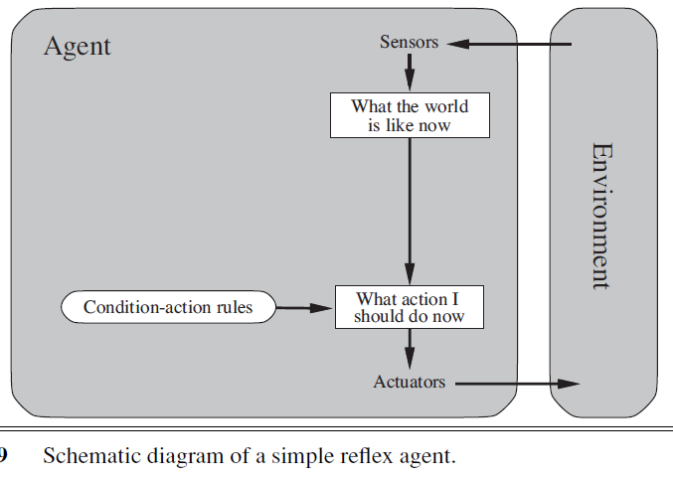
SIMPLE REFLEX AGENT PROGRAM
Characteristics of a Simple Reflex Agent
Based on the current percept only – It does not store past information.
Uses predefined condition-action rules – "If movement detected, open door."
Ignores history and future – It does not plan or learn from experience.
Performs well in fully observable environments – If the sensors provide complete information, it works fine.
Condition-Action Rules: IF motion detected, THEN open the door.
IF no motion for 5 seconds, THEN close the door.

Slide 8
SIMPLE REFLEX AGENT PROGRAM
Limitations of Simple Reflex Agents
No Memory → It cannot remember past states.
Limited Adaptability → It only follows fixed rules and cannot learn.
Fails in Partial Observability → If sensors fail or data is incomplete, it cannot handle uncertainty.

Slide 9
SIMPLE REFLEX AGENT PROGRAM
Understanding Simple Reflex Agents with a Real-World Example
Example: Smart Streetlight System
Imagine a smart streetlight system that turns ON at night and OFF during the day based on a light sensor.
How It Works as a Simple Reflex Agent
Sensors (Percepts): The system has a light sensor that detects brightness.
Condition-Action Rules:
IF brightness < 30%, THEN turn ON the streetlight.
IF brightness > 70%, THEN turn OFF the streetlight.
Actuators (Actions): The system turns ON or OFF the streetlight.
Environment: The outdoor surroundings where the streetlight operates.

Slide 10
SIMPLE REFLEX AGENT PROGRAM
Mapping to the Simple Reflex Agent Model
Component | Role in Smart Streetlight
Sensors (Percepts) | Light sensor detects brightness.
Condition-Action Rules | Simple "IF-THEN" logic to turn light ON or OFF.
Actuators (Actions) | Switches the light ON or OFF.
Environment | The street and surrounding area.
Why is This a Simple Reflex Agent?
No Memory: It only reacts to the current light level, not past states.
Fixed Rules: It does not adapt; it blindly follows "IF brightness is low, THEN turn ON" logic.
Fails in Complex Cases:
What if it is cloudy during the day? The streetlight might turn ON unnecessarily.
What if there is a power outage? It doesn’t adjust or learn.

Slide 11
SIMPLE REFLEX AGENT PROGRAM
Next Step: Making It Model-Based
Now, imagine we improve this system by allowing it to remember past brightness levels and predict patterns (like sunset times). That would make it a Model-Based Reflex Agent.

Slide 12
MODEL-BASED REFLEX AGENT PROGRAM
What is a Model-Based Reflex Agent?
A Model-Based Reflex Agent is a Rational system that maintains an internal model of the environment to make more informed decisions. Unlike Simple Reflex Agents, which react solely to current percepts, Model-Based Agents consider past states and transitions to handle partial observability.
Why is it Model-Based?
Maintains an internal state to keep track of unseen factors.
Uses a world model to understand how its actions affect the environment.
Overcomes the limitations of Simple Reflex Agents by making more intelligent decisions even in cases where direct perception is insufficient.

Slide 13
Model-Based Reflex Agent
Components of a Model-Based Reflex Agent
Percepts: The agent receives input from the environment.
Internal State: Maintains memory of past events to infer missing information.
World Model: Knowledge about how the environment works and evolves over time.
Condition-Action Rules: A set of predefined rules mapping conditions to actions.
Actions: The responses made by the agent based on percepts and internal state.

Slide 14
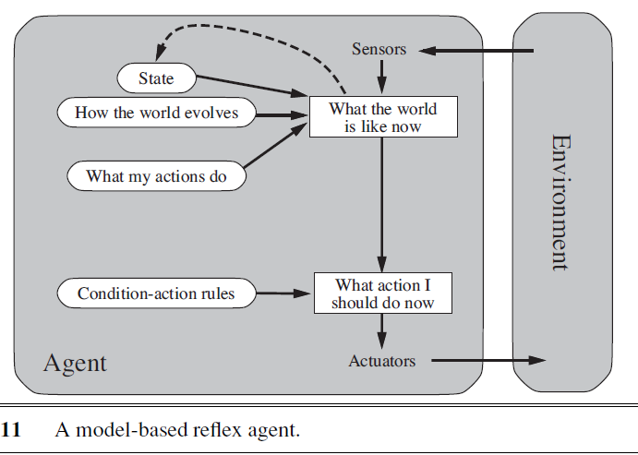
Model-Based Reflex Agent
External Percept (current temperature)
↓
Internal Percept (time since last action)
↓
[State Update] → Update Internal State (time since heater was last turned on)
↓
Internal State (last action time)
↓
[Condition-Action Rule] → Decide Action (based on percepts and internal state)
↓
Action (turn on heater)

Slide 15
Model-Based Reflex Agent
Transition from Simple Reflex to Model-Based Reflex Agent
Simple Reflex Agent Example: Street Light Control
Percept: Measures the brightness of the environment.
Condition-Action Rule: If brightness is low, turn on the streetlight; if brightness is high, turn it off.
Limitation: If a high-beam vehicle passes by, the sensor may think it's daytime and turn off the streetlight, which is incorrect.
Model-Based Reflex Agent Example: Improved Street Light Control
Percept: Measures brightness and detects sudden changes.
Internal State: Stores historical brightness levels over a short period.
World Model: Knows that rapid brightness increases are usually caused by passing vehicles, not sunrise.
Condition-Action Rule:
If brightness is low for a sustained period, turn on the streetlight.
If brightness increases suddenly but then drops again, ignore the spike and keep the light on.
If brightness gradually increases over time (indicating sunrise), turn off the light.

Slide 16
Model-Based Reflex Agent
Additional Scenarios
Cloud Cover Scenario
Issue with Simple Reflex Agent: If a thick cloud passes, the environment darkens temporarily, causing the light to turn on unnecessarily.
Model-Based Solution:
The agent maintains an internal state tracking past brightness trends.
If the darkness is temporary and clears quickly, it does not turn on the lights.
If the darkness persists (indicating nightfall), it turns on the light.
Heavy Vehicle Passing By
Issue with Simple Reflex Agent: The headlights of a large vehicle could trigger the streetlight to turn off incorrectly.
Model-Based Solution:
The agent checks for sudden, short-lived brightness spikes.
If detected, it recognizes them as vehicle headlights and ignores them.
If brightness remains high over time (natural daylight), it turns off the streetlight.

Slide 17
Comparison with Simple Reflex Agent
By incorporating both external and internal percepts, the model-based reflex agent can make more informed decisions, leading to more efficient and effective behavior.
"Informed decisions" in the context of a model-based reflex agent refer to decisions made with more knowledge and awareness of the current situation.

Slide 18
GOAL-BASED AGENT PROGRAM
1. What is a Goal-Based Agent?
A Goal-Based Agent takes decisions based on a desired goal. Instead of reacting only to the current situation (like reflex agents), it evaluates possible future actions and chooses a sequence of actions that will achieve its goal.
Key Characteristics:
Decision-making is goal-oriented (it focuses on reaching a target state).
Considers future actions rather than just reacting to the current state.
Uses search and planning to determine a path to the goal.
Does not evaluate the quality of the route—it just ensures that the goal is reached.

Slide 19
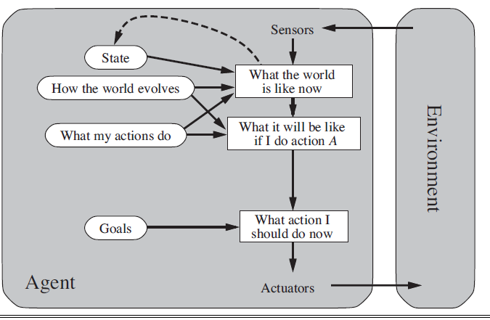
GOAL-BASED AGENT PROGRAM

Slide 20
GOAL-BASED AGENT PROGRAM
Example: Self-Driving Car Reaching a Destination
Scenario: A self-driving car must travel from Point A to Point B.
How the Goal-Based Agent Works:
Percepts: The car senses its location and the road conditions.
World Model: The car knows the road network and traffic rules.
Goal Condition: "Reach Point B."
Possible Routes:
Route 1 (shorter but congested).
Route 2 (longer but clear).
Route 3 (alternative path).
Action Selection:
The car chooses any route that leads to Point B.
It may not always pick the best route—it just ensures goal completion.
Execution: The car follows the selected route and reaches B.

Slide 21
GOAL-BASED AGENT PROGRAM
Limitations of Goal-Based Agents
Does not evaluate the best route—only cares about reaching the goal.
Might choose an inefficient path if multiple options exist.
Cannot differentiate between a bad and a good driving experience (e.g., avoiding bumpy roads or heavy traffic).
Transition to Utility-Based Agent
A Goal-Based Agent only cares about reaching the goal.
A Utility-Based Agent improves decision-making by choosing the best path based on factors like fuel efficiency, speed, and comfort.

Slide 22
UTILITY-BASED AGENT PROGRAM
Utility-Based?
A Utility-Based Agent not only aims to reach the goal but also maximizes "happiness" (utility).
It assigns a numerical value to different outcomes and chooses the best path based on how safe, comfortable, and efficient it is.
Happiness vs. Unhappiness in Utility
Happy scenario: Choosing a smooth, efficient, and safe route that minimizes stress for passengers.
Unhappy scenario: Stuck in heavy traffic with sudden braking and inefficient fuel usage, leading to discomfort and frustration.

Slide 23
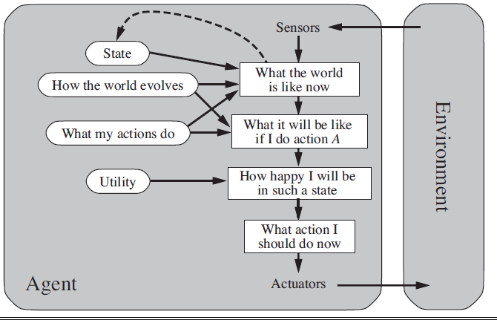
UTILITY-BASED AGENT PROGRAM

Slide 24
UTILITY-BASED AGENT PROGRAM
Utility Function and How It Works in a Utility-Based Agent
In a Utility-Based Agent, we don't just care about reaching the goal—we care about reaching it in the best possible way. The agent assigns a utility value (a numerical score) to different possible outcomes and picks the one with the highest utility.
How Utility Function Works
A utility function takes different factors as input and assigns a numerical score based on how desirable the outcome is.
The agent evaluates multiple possible actions and selects the one that maximizes utility.
Higher utility means a better choice, and the agent tries to achieve the maximum utility at every step.

Slide 25
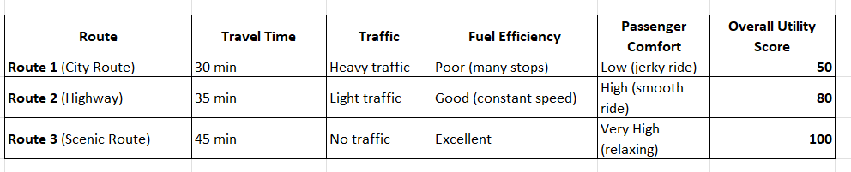
UTILITY-BASED AGENT PROGRAM
Example: Self-Driving Car Choosing a Route
Scenario:
A self-driving car must travel from Point A to Point B. It has three possible routes, each with different conditions.
Utility Scores Explanation:
Route 1 (50 Utility Score): Shortest time, but high traffic, frequent stops, and uncomfortable ride lower the score.
Route 2 (80 Utility Score): Slightly longer, smooth ride, steady speed, and fuel-efficient, making it a good choice.
Route 3 (100 Utility Score): The most comfortable, safest, and fuel-efficient, but takes more time.

Slide 26
UTILITY-BASED AGENT PROGRAM
A Utility Function assigns a numerical value (utility) to different possible outcomes, helping the agent make the best decision rather than just any decision that meets the goal.
Here:
U = Total utility (happiness/satisfaction of the system).
w₁, w₂, w₃, w₄ = Weights assigned to each factor based on priority.
Safety, Fuel Efficiency, Travel Time, Passenger Comfort = Different factors considered for decision-making.

Slide 27
UTILITY-BASED AGENT PROGRAM
For example:
Route 1: Safety = 90, Fuel Efficiency = 70, Travel Time = 60, Passenger Comfort = 80
Route 2: Safety = 75, Fuel Efficiency = 85, Travel Time = 50, Passenger Comfort = 70

